Slide 1


Slide 2
About today…
React Forms
Handling Inputs
Form Validation

Slide 3
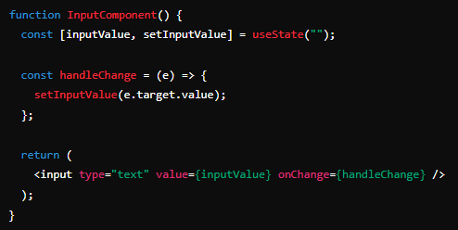
Intro to User Input in React
Handling User Input
React components can capture user input through form elements like
<input>
<textarea>
<select>
Input data is usually handled via state in React
Example
Basic Input Handling

Slide 4
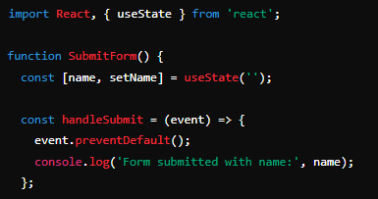
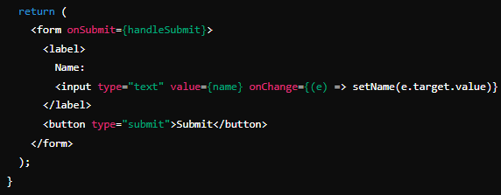
Handling Form Submission
Event Handling
Use the onSubmit event for form submission
Prevent default form behavior using event.preventDefault()
Example
Submitting a form with controlled components

Slide 5
Intro to Form Validation
Form Validation
Ensuring user input meets the required criteria before form submission
Prevents invalid data from being processed
Types
Client-side Validation
Performed in the browser before data is sent to the server
Server-side Validation
Performed on the server after data is sent

Slide 6
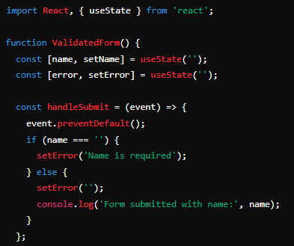
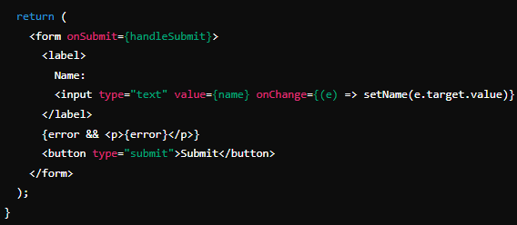
Implementing Basic Form Validation
Client-Side Validation
Ensure user inputs meet certain criteria before submission
Examples: Required fields, email format, min/max length
Example
Simple validation in a controlled component

Slide 7
Using Third-Party Libraries
Popular Libraries for Form Handling and Validation
Formik
Helps with managing form state, validation, and handling form submissions
Yup
Schema builder for value parsing and validation

Slide 8
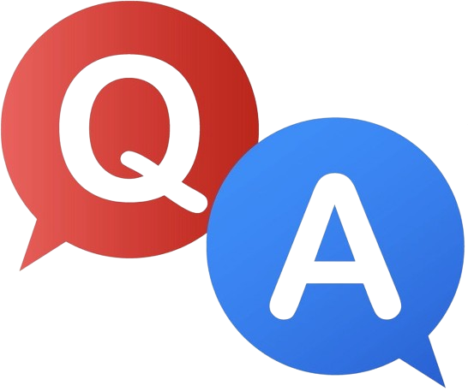

Slide 9

Tell a few valid form element in HTML?
<input>
<form>
<select>
<element>
What is client-side validation?
Validation performed in the user's browser before submitting data
Which HTML attribute specify that an input field must be filled out before submitting the form?
required

Slide 10

Task 1
Create a registration form in React that captures user input and performs basic validation
Task 2
Create a form with basic validation to ensure that all fields are filled before submission

